Slide 1

Downstream Drift:
How ‘health’ hinders preventive policy
Dr Ally Brown
University of Strathclyde​
With plenty help from: Kat Smith, Lisa Garnham, Gillian Fergie, Anna Macintyre, Clemmie Hill O’Connor, Julia Lynch, Mark Petticrew, Shona Hilton, Emma Hill, Margaret Douglas and others

Slide 2
Today
What’s the problem with prevention?
What is ‘Downstream Drift’?
The six mechanisms of Downstream Drift
Discussion (breakouts + whole group)
What can be done about Downstream Drift?
Discussion (breakouts + whole group)

Slide 3
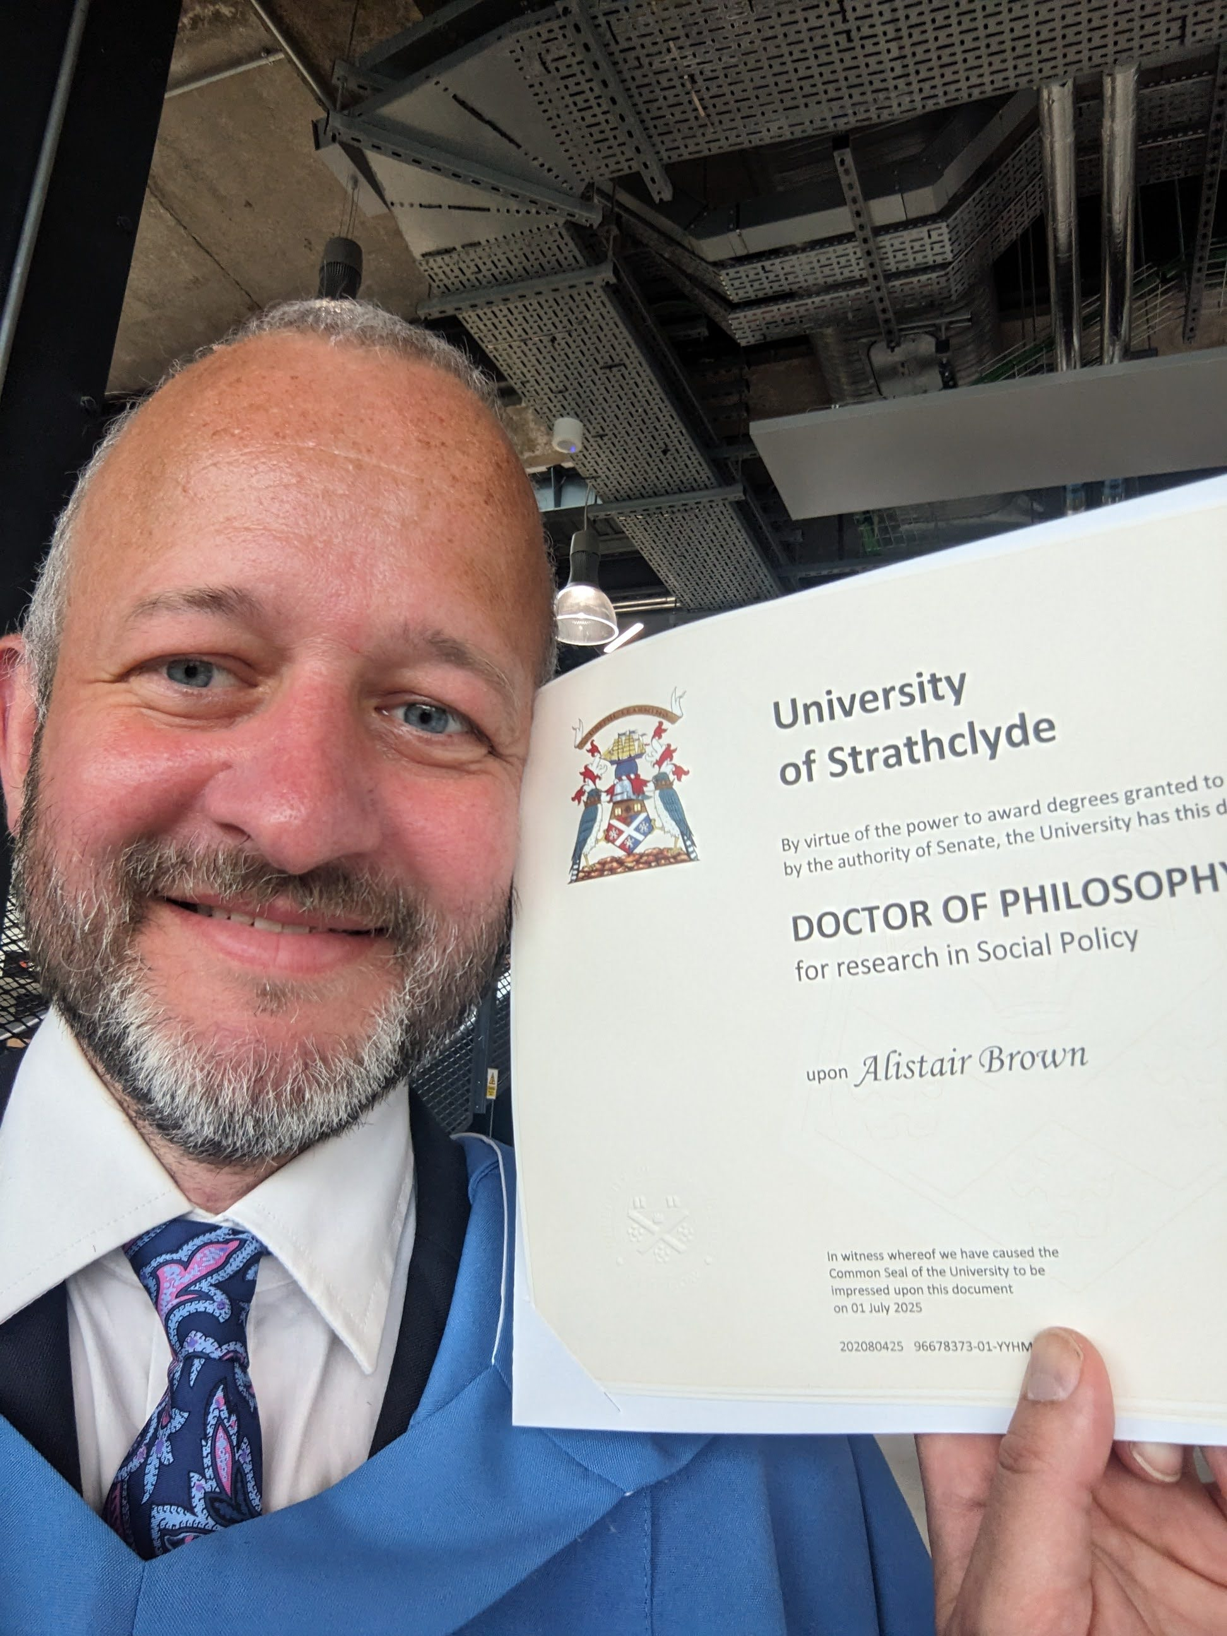
Me, myself and I
Research Associate at University of Strathclyde working in SWSP on THRIVING Food Futures project.
From Paisley, via Edinburgh, Bogotá, Barcelona and Haddington.
LLB and MPH from University of Edinburgh, then PhD from Strathy.

Slide 4



My research
Two sub-national devolved case studies
  Greater Manchester Combined Authority (GMCA), and the Scottish Government (SG).
Frame analysis of 30 policy strategy docs 2017-22
  I identified five forms of idea accompanying ‘health’ in each text: causal stories, problem definitions, proposed solutions, relevant actors, and moral claims.
Interviews with 33 policymakers 2022-23
  I spoke to policymakers from health, social and economic policy teams.
  A year working with SG, PHS and COSLA on a new preventive approach to mental health
This work was supported by the UK Prevention Research Partnership, an initiative funded by UKRI Councils, the Department of Health and Social Care (England), the UK devolved administrations, and leading health research charities.

Slide 5
What’s the problem with prevention?
1

Slide 6
“The whole nature of this is that the health service has really got to change in its next 60 years from being the curative service—where it’s done so much good—to being also a preventative service.”
– Prime Minister Gordon Brown, 2008

Slide 7
“Over the course of this Parliament Scotland's public services will make a decisive shift towards prevention and take a holistic approach to addressing inequalities. This focus is essential to address the current squeeze on the Scottish budget, tackle persistent inequalities and ensure the sustainability of our public services in the longer term.
– Scottish Government, 2011

Slide 8
“The most important way of spending to save is to invest in prevention.”
– Health Secretary Jeremy Hunt, 2018

Slide 9
“We must change the NHS so that it becomes not just a sickness service, but able to prevent ill health in the first place.”
– Labour Party manifesto, 2024

Slide 10
“Realising our aim requires a whole system response in which prevention is embedded across all parts of government and all sectors”
– Scottish Government, 2025

Slide 11
“Putting prevention first”
– Scottish Government, last week

Slide 12
“Being for prevention is like being against sin.”
– Richard Freeman, 1999

Slide 13
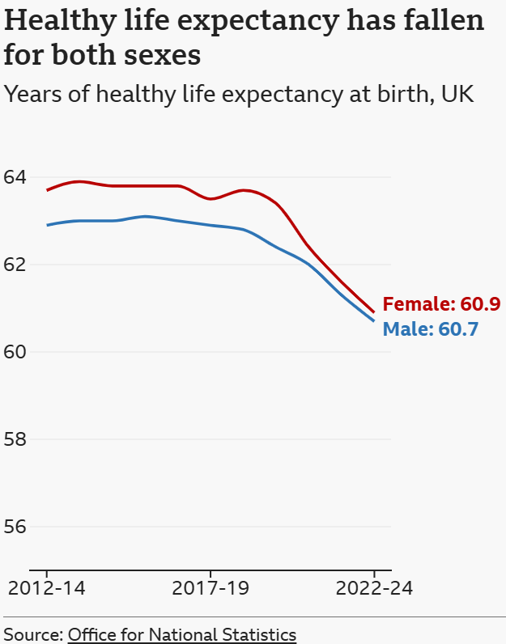
So why is prevention so hard?
What does prevention mean?
What are we hoping to prevent?
How can we think longer-term?
Today beats tomorrow, every day.
How can we know our preventive policies are working?
The dog that doesn’t bark (or perhaps it will, 20 years later).
How can we co-ordinate policy to prevent ill-health?
‘Health in All Policies’ is easier said than done.

Slide 14
What is ‘Downstream Drift’?
2.​
Ideas, frames & paradigms
Two competing paradigms of ‘health’
Medicalisation
Lifestyle Drift

Slide 15
“Very frequently the ‘world images’ that have been created by ‘ideas’ have, like switchmen, determined the tracks along which action has been pushed by the dynamic of interest”
– Max Weber, 1946

Slide 16
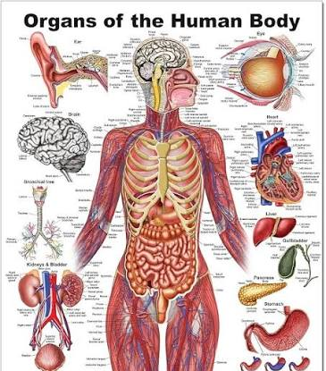
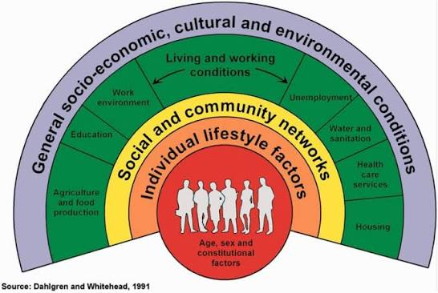
The two competing models of ‘health’
Dahlgren, G., & Whitehead, M. (1991). Policies and strategies to promote social equity in health. WHO Regional Office for Europe.
Medical: individuals, biology (chemistry, physics): “what we’re made of”.
Social: populations, social sciences: “what we’re part of”.

Slide 17
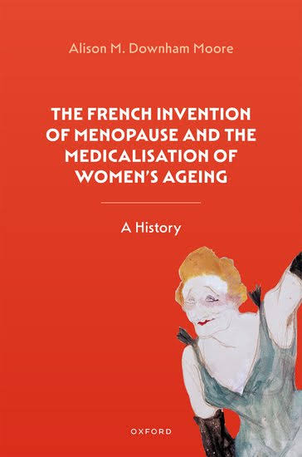
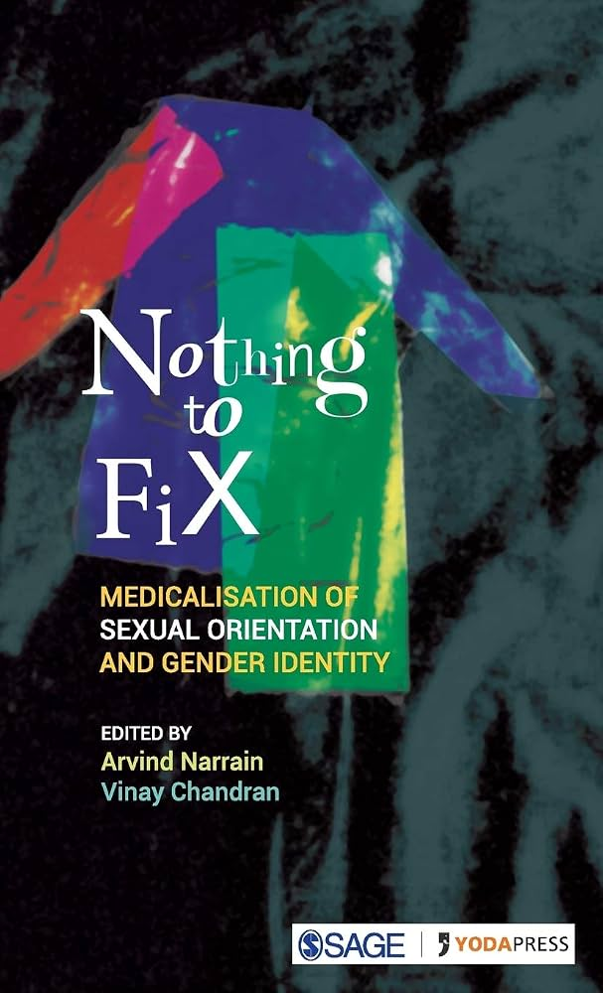

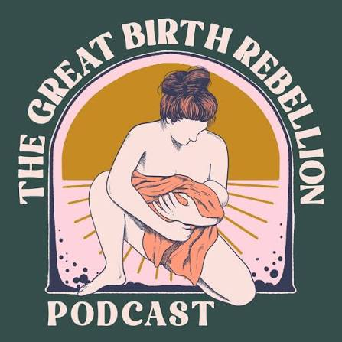
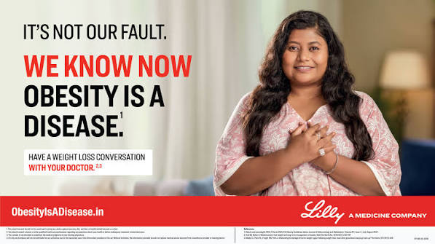
Medicalisation:
“when non-medical problems become defined and treated as medical problems” (Conrad, 2007)

Slide 18
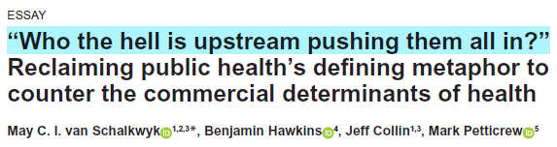
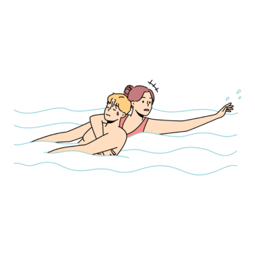
‘Lifestyle Drift’
‘Lifestyle Drift’ = upstream social problems, downstream ‘lifestyle’ solutions
‘Downstream Drift’ = upstream social problems, downstream individual solutions

Slide 19
The six mechanisms of ‘downstream drift’
3.​

Slide 20
My findings
Health as individual
Health as (physical) ill-health
Heath as shorthand for health policy
This work was supported by the UK Prevention Research Partnership, an initiative funded by UKRI Councils, the Department of Health and Social Care (England), the UK devolved administrations, and leading health research charities.

Slide 21

The six mechanisms of downstream drift
Health as health policy
“Health’s business to fix”
“A battle, all the time”
“Which two nurses do you sack?”
Health as individual ill-health
4. “Promoting active, healthy lifestyles”
5. “The thing you go to the doctor with”
6. “That’s not health, that’s just a number that you have”

Slide 22
“Health’s business to fix”: the misattribution of preventive policy

Slide 23
“Health inequalities is an interesting one because I think, almost by calling it health inequalities, it’s health’s business to fix […] you know, the response to the climate emergency isn’t just the environment portfolio’s responsibility, we’ve all got a job to do here, and I think one of the things about health inequalities particularly is I think it does end up going ‘oh that’s a health thing, health need to deal with that’.”
– GMCA policymaker

Slide 24
“All members of the Task Force were clear that the focus of all our efforts should be on tackling inequalities. Moreover, they reflected that by targeting health inequalities we may have inadvertently allowed different parts of the public sector to think that this focus did not apply to their organisation, and that responsibility to resolve the problems arising from inequalities lies only with the National Health Service (NHS).”
(Ministerial Task Force for Health Inequalities, Scottish Government, 2014)

Slide 25
“This programme is about mental health, our sphere of influence is about mental health, interventions need to have mental health focus, we just need to be clear about what we can do, in practical terms.”
- SG policymaker

Slide 26
“Health’s business to fix”: the misattribution of preventive policy
  “Health inequalities is an interesting one because I think, almost by calling it health inequalities, it’s health’s business to fix […] you know, the response to the climate emergency isn’t just the environment portfolio’s responsibility, we’ve all got a job to do here, and I think one of the things about health inequalities particularly is I think it does end up going ‘oh that’s a health thing, health need to deal with that’.” [GMP01O].
  “All members of the Task Force were clear that the focus of all our efforts should be on tackling inequalities. Moreover, they reflected that by targeting health inequalities we may have inadvertently allowed different parts of the public sector to think that this focus did not apply to their organisation, and that responsibility to resolve the problems arising from inequalities lies only with the National Health Service (NHS).” (Ministerial Task Force for Health Inequalities, Scottish Government, 2014)
  “This programme is about mental health, our sphere of influence is about mental health, interventions need to have mental health focus, we just need to be clear about what we can do, in practical terms.” (SG MH policymaker)
Notes:
.

Slide 27
“A battle, all the time”: fighting 'fortress health'

Slide 28
“I don’t like coming in and saying this is about getting health in all policies, because I think that doesn’t land well with policy teams outwith DG Health. Because there’s this, people talk about fortress health, and the health budget has been protected at all costs really for the last 10-15 years […] I guess it’s that, just from an interpersonal effectiveness kind of respect, I don’t think that us going out and saying, ‘what can you do for health?’ is the way to engage people.”
- SG policymaker

Slide 29
“A battle, all the time”: fighting 'fortress health'
“I don’t like coming in and saying this is about getting health in all policies, because I think that doesn’t land well with policy teams outwith DG Health. Because there’s this, people talk about fortress health, and the health budget has been protected at all costs really for the last 10-15 years […] I guess it’s that, just from an interpersonal effectiveness kind of respect, I don’t think that us going out and saying, ‘what can you do for health?’ is the way to engage people.” [SCOP14H].
  Population health actors were criticized for crossing policy boundaries: “go round telling other bits of the system what they think they ought to be doing... and a fair amount of time, piss other people off”
Healthcare actors were criticised for not crossing policy boundaries: “it’s a battle to get this wider determinant stuff on the table"

Slide 30
"Which two nurses do you sack?“: Prevention versus the NHS
“Prevention’s a really tricky one because we know public finances are always tight. Which two nurses do you sack so you can have someone intervening earlier?” [SCOP18O]

Slide 31
“Let’s just be really clear, the reason why we’re not investing £1bn in health inequalities is not because we’ve made some stupid choice, it’s because the biggest workforce in Scotland have decided that what they want to value in a way that’s politically unavoidable is putting every last penny we’ve got into increasing their pay [...] that effectively creates a further pressure where people then say, well you should be spending a lot more money on tackling health inequalities”. [SCOP07H]
- Senior SG policymaker

Slide 32
"Which two nurses do you sack?“: Prevention versus the NHS
“Prevention’s a really tricky one because we know public finances are always tight. Which two nurses do you sack so you can have someone intervening earlier?” [SCOP18O]
“Let’s just be really clear, the reason why we’re not investing £1bn in health inequalities is not because we’ve made some stupid choice, it’s because the biggest workforce in Scotland have decided that what they want to value in a way that’s politically unavoidable is putting every last penny we’ve got into increasing their pay [...] that effectively creates a further pressure where people then say, well you should be spending a lot more money on tackling health inequalities”. [SCOP07H]

Slide 33
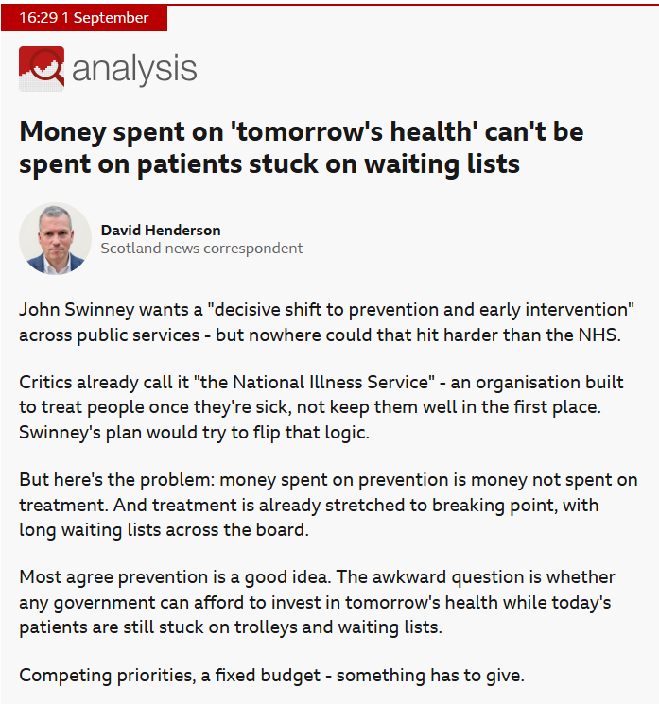
https://www.bbc.co.uk/news/live/cq0lrz6j0ylnt [published 01/09/2026, accessed 02/09/26]

Slide 34
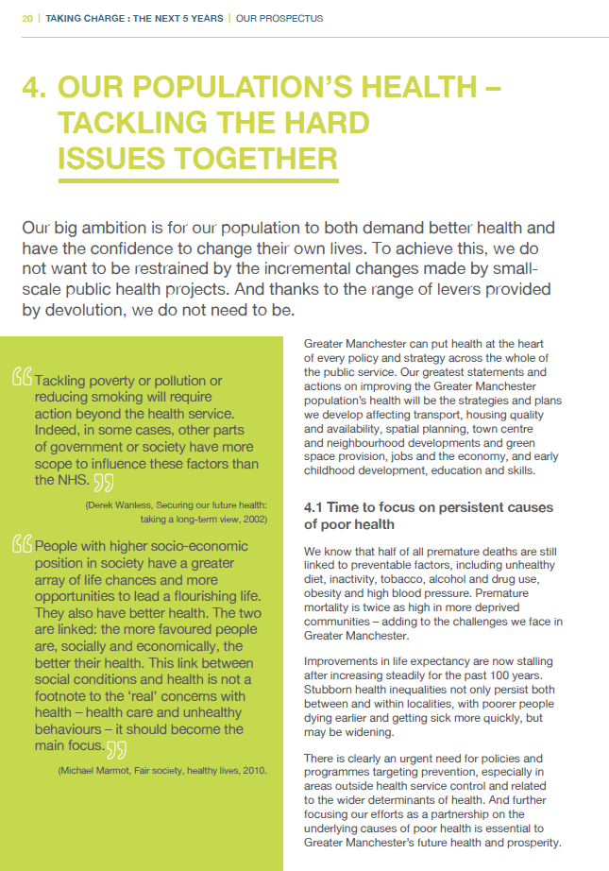
"Promoting active, healthy lifestyles": agency as the cause of individual illness
Notes:
’

Slide 35

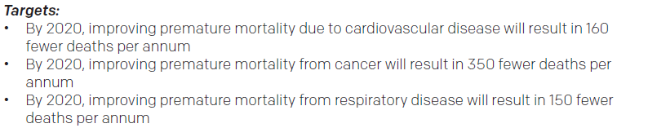
"The thing you go to the doctor with": pathology as the cause of individual illness

Slide 36
“The other thing on that of course is that it’s a fairly downstream indicator, and it’s generational… what we do in terms of improving our population health? I mean I suppose there are things we can do to reduce the number of people dying from cancer, but it’s very much at the tail end of that journey, isn’t it? It’s about identifying cancer quickly and then getting people into the system, get the treatment they want quicker.”
– GMCA policymaker

Slide 37
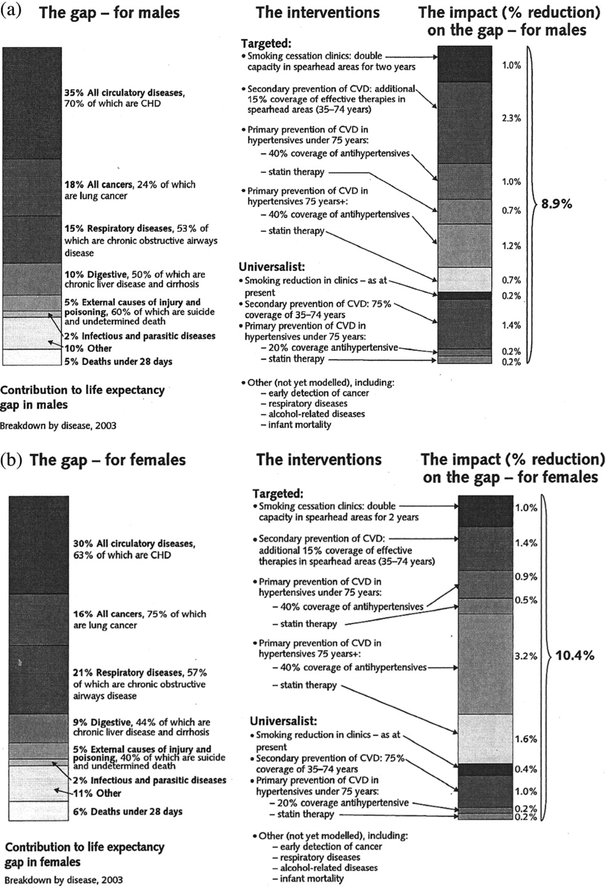
"The thing you go to the doctor with": pathology as the cause of individual illness
Qureshi, K. (2013). It’s not just pills and potions? Depoliticising health inequalities policy in England. Anthropology & Medicine, 20(1), 1–12. https://doi.org/10.1080/13648470.2012.747593

Slide 38
“Health is being redistributed pharmacologically by statins, antihypertensives, and nicotine replacement therapy. This is creating the paradoxical situation of a medical rather than a social model of public health, and a key role for pharmaceutical companies in a new definition of prevention based on drugs.
Blackman, T. (2007). Statins, saving lives, and shibboleths. BMJ, 334(7599), 902–902.

Slide 39
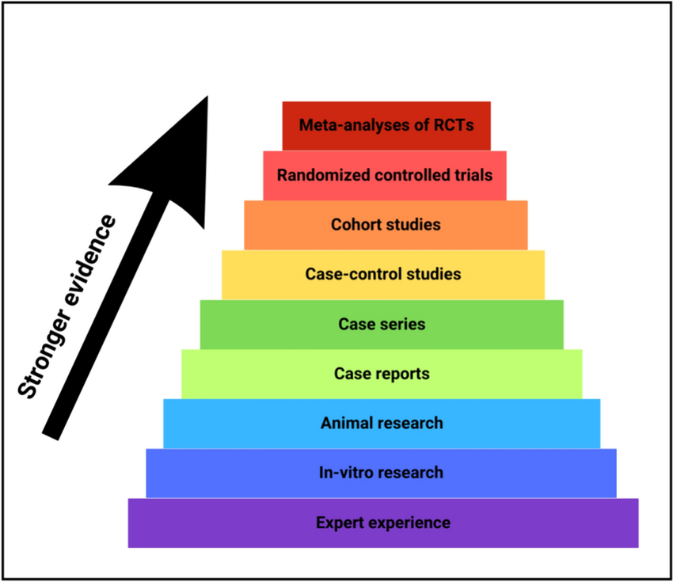
"That’s not health, that’s just a number that you have": health's association with ‘evidence-based medicine’

Slide 40
“It doesn’t matter if it decreases your serotonin but increases your mental health issues. I would say sometimes with health folk they go to a health outcome and I’m like ‘that’s not health, that’s just a number that you have’.”
- SG policymaker

Slide 41
"That’s not health, that’s just a number that you have": health's association with ‘evidence-based medicine’

Slide 42
“When you’re talking about health […] we basically had an internal conversation about diet and health and would reducing meat intake be beneficial for health? Because people were saying it would, people were saying it wouldn’t and we were just like, this is too much, we need a baseline of information. So some [external] research was commissioned […] Because without, people would be ‘actually no, wait a minute, we need to have X, Y, Z research to actually prove that that’s the case’.”
- SG policymaker

Slide 43
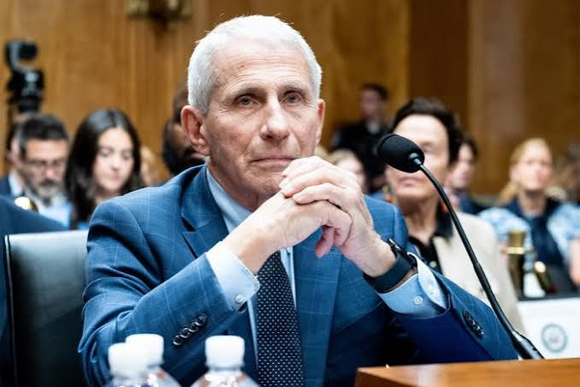
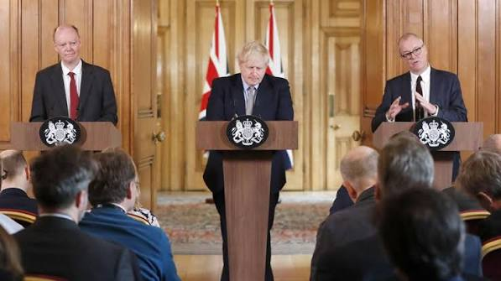
"That’s not health, that’s just a number that you have": health's association with ‘evidence-based medicine’

Slide 44
“[Being arms-length] is so important, I think, in terms of our integrity and the trust that the public and other partners have in us, so we can’t be accused ‐ although we are being accused in the MUP evaluation ‐ but there’s fidelity there to the evidence and public health expertise view of what that evidence tells us.”
- PHS interviewee

Slide 45
The six mechanisms of downstream drift
Where do these mechanisms trigger?
Health policy
Health in All Policies
Health inequalities
Public Health
Mental Health
…
Health improvement
Health promotion
Occupational health
Population health
“Health’s business to fix”
“A battle, all the time”
“Which two nurses do you sack?”
“Promoting active, healthy lifestyles”
“The thing you go to the doctor with”
“That’s not health, that’s just a number that you have”

Slide 46
4. Discussion
What resonates with you?
Have you seen this in your work, in other contexts, or in things you’ve read?
What might I be wrong about?
What questions do you have?
(Solutions, coming next!)

Slide 47
What can be done about ‘Downstream Drift’?
5.

Slide 48
The two competing models of ‘health’
Dahlgren, G., & Whitehead, M. (1991). Policies and strategies to promote social equity in health. WHO Regional Office for Europe.
(Health)care
Wellbeing
(Health)care: whole person-centred, today-focused.
Medical: individuals, biology (chemistry, physics): “what we’re made of”.
Social: populations, social sciences: “what we’re part of”.
Wellbeing: whole public-centred, tomorrow-focused.

Slide 49
Why ‘Wellbeing’?
Directs attention to social & economic policy determinants of health
Dahlgren, G., & Whitehead, M. (1991). Policies and strategies to promote social equity in health. WHO Regional Office for Europe.

Slide 50
“Maybe it’s also my interpretation of wellbeing, I then would really start to factor in the wider determinants of health […] I think that then wholly encompasses all of the work we do.”
- GMCA policymaker

Slide 51
“Not just health in particular, but also how trade impacts the everyday life of people, so looking at their jobs, equality in general, their environment, so that all falls under the wellbeing principle.”
- SG policymaker (trade)

Slide 52
Why ‘Wellbeing’?
Directs attention to social & economic policy determinants of health
Concerned with physical, mental, emotional, social
Potential common cause
Dahlgren, G., & Whitehead, M. (1991). Policies and strategies to promote social equity in health. WHO Regional Office for Europe.

Slide 53
“’Wellbeing’ is a lot broader isn’t it? So you’re trying to capture a lot more aspects there. Whereas I think in a way you open the floodgates if you put ‘health’, then someone could say well why didn’t you put ‘climate’ or, you know what I mean.”
- SG policymaker

Slide 54
Why ‘Wellbeing’?
Directs attention to social & economic policy determinants of health
Concerned with physical, mental, emotional, social
Potential common cause
‘Wellbeing Economy’
Dahlgren, G., & Whitehead, M. (1991). Policies and strategies to promote social equity in health. WHO Regional Office for Europe.

Slide 55
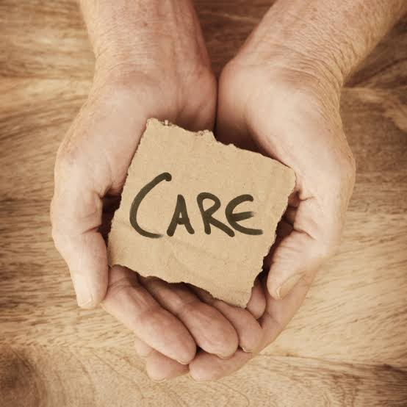
Or perhaps ‘Healthcare’?
Why ‘Care’?
Person-centred
Today-focused
Is ‘healthcare’ and ‘social care’ a helpful conceptual division?
Is ‘care’ too broad?

Slide 56
What can we do about ‘Downstream Drift’?
5b.

Slide 57
6. Discussion
What wriggle-room exists in your part of the system?
How can we avoid Downstream Drift?
How do you feel about splitting ‘health’ into (health)care and wellbeing?
What questions do you have?
What ideas do you have?

Slide 58
Thanks very much!
Brown, A. (2025). Reframing health inequality? The rise, rise and fall of three competing policy frames. Journal of Public Health, 48(1), fdaf141.
Brown, A. (2026). Framing health inequalities to tell political stories: Devolution makes the difference. Journal of Critical Public Health.
Brown, A. (2026). Searching for the social model of health in policy: Health in All Policies, or Wellbeing? Journal of Social Policy [accepted, to be published imminently]

Slide 59
Thanks very much!
Downstream Drift: How ‘health’ hinders preventive policy will be published by Policy Press in November 2027.
Please e-mail me for further chat or feedback, a cheap paperback, or a free PDF!
alistair.brown@strath.ac.uk
Notes:
And finally…

